Slide 1
MANAGEMENT INFORMATION SYSTEMS
Chapter 11: Artificial Intelligence

Slide 2
Artificial Intelligence

Slide 3
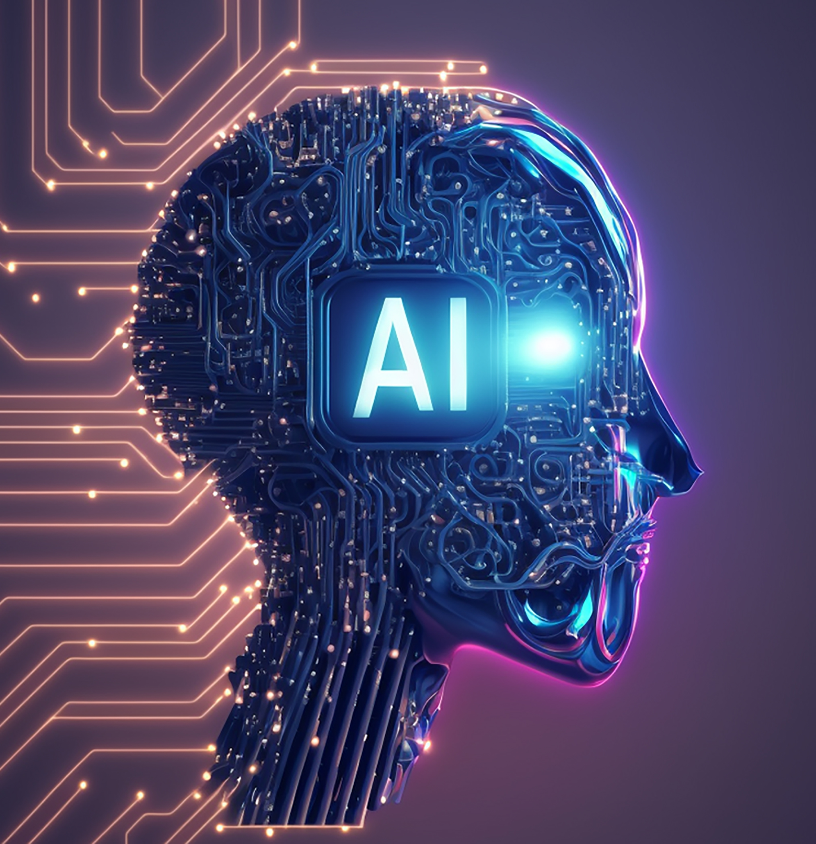
What Is Artificial Intelligence?
Artificial Intelligence (AI)
Systems that perform tasks that normally require human intelligence.
e.g, Pattern recognition, speech recognition, prediction, decision support, and content generation.
Why AI matters for businesses:
Organizations want tools to reduce costs, innovate, and create value.
AI is used in products, services, operations, and decision making.
AI helps firms automate routine work and enhances decision making through predictive and prescriptive analytics.

Slide 4
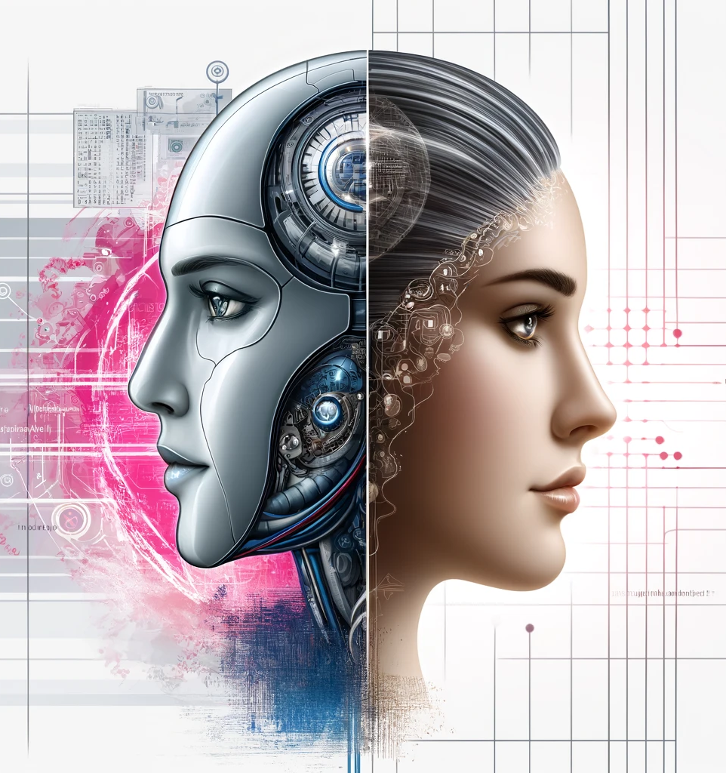
AI: Strengths and Weaknesses
AI’s Strengths
Processes large amounts of data very quickly.
Learns patterns and improves accuracy over time.
Performs specialized tasks with high reliability.
Identifies trends in data that humans may overlook.
Effective at tasks it was designed and trained for.
AI’s Limitations
Lacks human-level adaptability and intuition.
Has no emotional context or subjective judgment.
Performs poorly when facing unfamiliar or insufficient data.
Cannot fully replicate creativity or cultural understanding.
Struggles with unfamiliar situations without retraining.

Slide 5
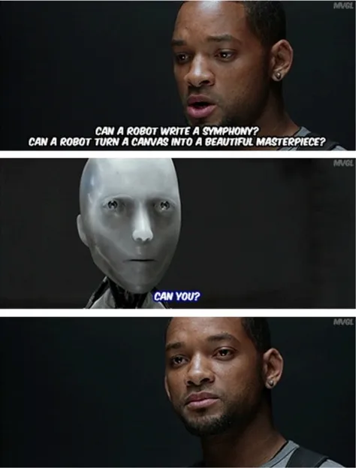
Language, Creativity, and Emotion
Natural Language Processing
AI can interpret and generate human language.
AI may misinterpret sarcasm, humor, indirect language, or culturally specific expressions.
Creativity
AI generates ideas and content based on training data.
Humans create novel ideas that are not constrained by past data.
Emotion
AI can detect emotions but does not experience them.
Human emotions influence communication and decision making.

Slide 6

Alexis Wang (2025, February 14). Keyboard_Waltz in F# Minor_1635 [Video]. YouTube. https://youtu.be/mNpegaVDloU?si=-uUct8pfs_lLoOHr

Slide 7
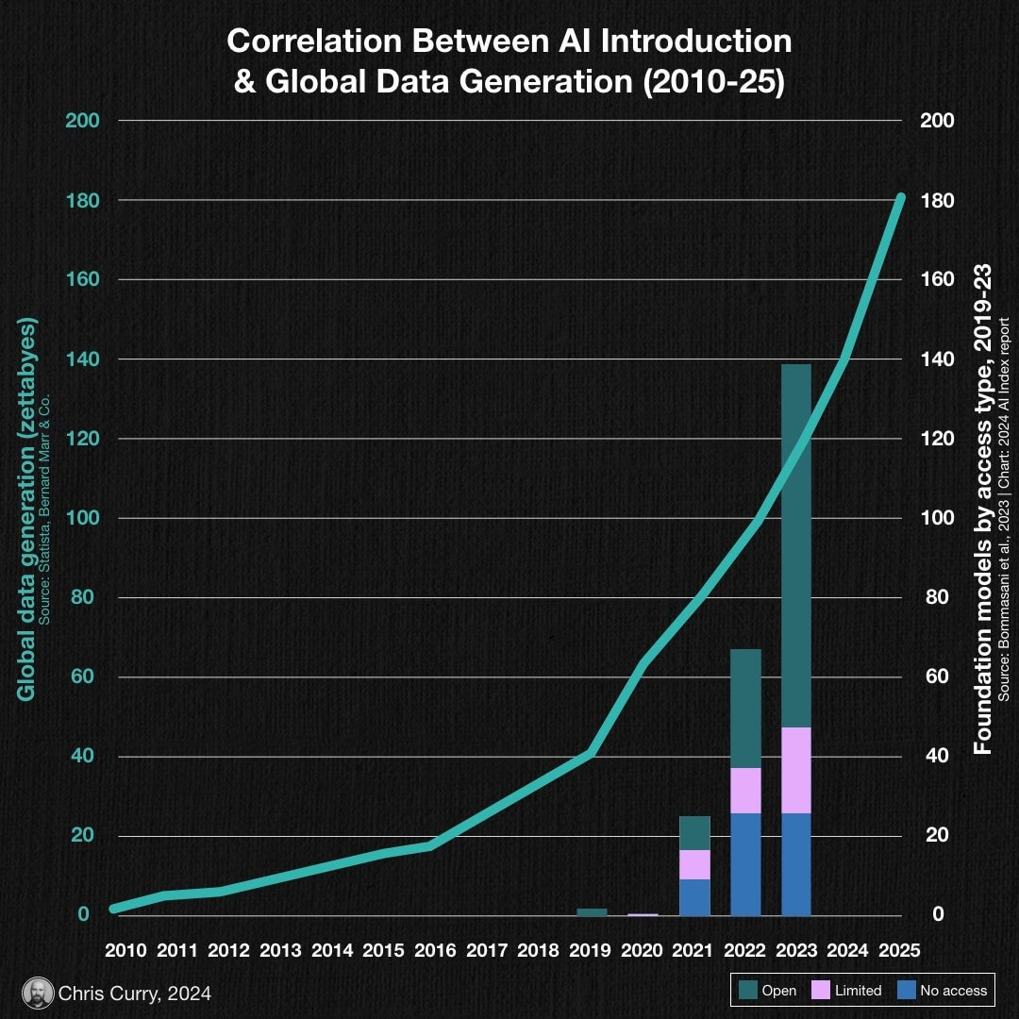
Rapid Growth of AI
Abundant big data from digital platforms.
Lower cost of computing hardware.
Stronger processors and specialized chips for AI.
Cloud computing that provides scalable AI processing.
Advances in algorithms produced by researchers.
Large investments from firms and governments in AI research.

Slide 8
Types of AI Technology
Machine Learning
Machine learning uses algorithms that learn patterns from data and make predictions or decisions without explicit programming.
e.g., Uber using ML to forecast demand, or Amazon using ML for product recommendations.
Neural Networks and Deep Learning
Loosely inspired by the human brain, deep learning uses many layers of these networks to identify very complex patterns in data.
e.g., ChatGPT, Gemini, and Copilot use large language models.
Genetic Algorithms
Algorithms inspired by natural selection. They search for optimal solutions by simulating evolution.
e.g., Boeing uses genetic algorithms for aerodynamic wing design.

Slide 9
Types of AI Technology
Natural Language Processing
NLP enables computers to understand, interpret, generate, and analyze human language.
e.g., Gmail classifies emails based on content, or support centers using sentiment analysis.
Computer Vision
Computer vision allows machines to interpret images and video and extract useful information.
e.g., Audi uses computer vision to detect microscopic cracks in metal parts, and medical imaging systems can identify tumors.
Robotics
Robotics involves machines that perform physical tasks and use sensors and software to control movement and processing.
e.g., Amazon uses robots to move products safely and efficiently.

Slide 10
Types of AI Technology
Intelligent Agents
Software agents that act on behalf of a user or system to perform tasks using built-in or learned knowledge.
e.g., Siri, Alexa, and Google Assistant answer questions and perform tasks.
Expert Systems
Software that uses the knowledge of human experts represented as rules to solve problems in a narrow domain.
e.g., Legacy diagnostic systems in medicine and maintenance.
Fuzzy Logic
A reasoning approach that deals with imprecise or subjective input using degrees of truth rather than strict yes or no decisions.
e.g., Automobile climate control systems that set temperature based on subjective comfort ranges.

Slide 11

Boston Dynamics (2022, May 3). No Time to Dance | Boston Dynamics [Video]. YouTube. https://youtu.be/6U-bI3On1Ww?si=9LYUvoNETs619fjb

Slide 12
Machine Learning

Slide 13
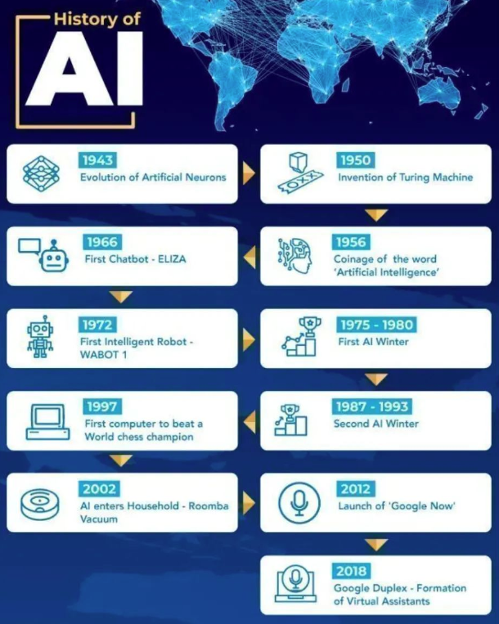
From Rule-Based Systems to Machine Learning
Early AI systems were “rule-based.”
Used predefined “if then” rules to make decisions.
Expert systems required human experts to encode knowledge.
Limited flexibility because rules could not adapt or improve.
Expensive to update and only worked in narrow domains.
Modern AI Systems Evolved
ML systems learn patterns from data rather than fixed rules.
Allows computers to improve performance automatically through experience.
Supports more complex, flexible, and accurate decision making..

Slide 14
What Is Machine Learning?
Definition
Machine learning uses mathematical models that learn from large quantities of data and identify patterns or make statistical inferences.
ML improves over time as it receives more data.
Key Features
Learns relationships in data without much explicit programming.
Highly effective for analyzing massive datasets that humans cannot process.
Used for classification, prediction, and decision support.
Why it Matters
Fast, scalable analysis across industries.
Often more accurate than human judgment for pattern recognition tasks.

Slide 15
Applications of ML
Applications
Natural language processing for chatbots that provide personalized assistance.
Image recognition systems that detect objects, writing, or people.
Predictive analytics that estimate future trends or customer behavior.
Recommendation systems that personalize content based on past actions.
Organizational Benefits
Enhances customer experience.
Supports targeted marketing and personalization.
Improves operational efficiency through automation and prediction.

Slide 16
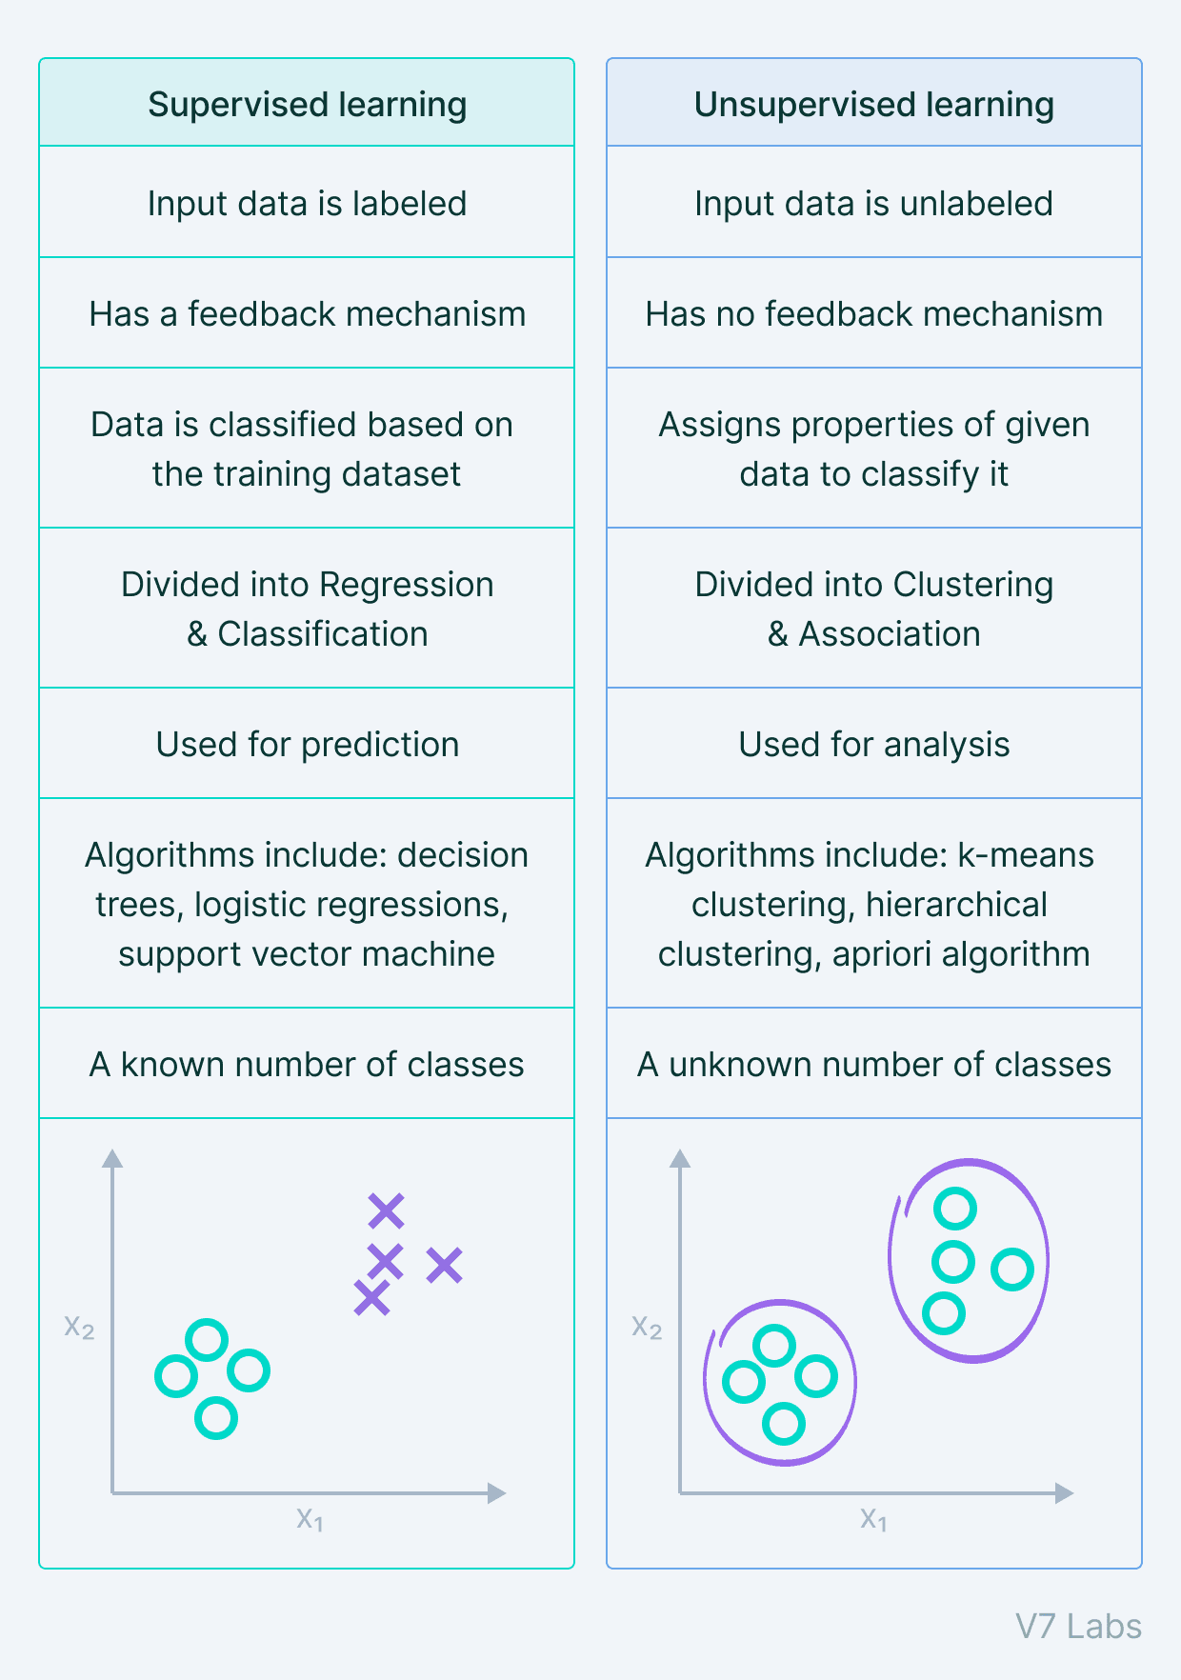
Supervised Learning
Definition
The system is trained using labeled examples created by humans.
Input data and correct outputs are provided in advance.
How it works
The algorithm learns to map inputs to outputs.
Performance improves as it compares predictions with correct labels.
Programmers refine the model using more data and tuning methods.
Examples
Image classifiers trained to recognize cats, people, or road signs.
Autonomous vehicle systems identifying pedestrians, cars, and lane markings.
Fraud detection models learning from known cases of fraud.

Slide 17
Unsupervised Learning
Definition
The algorithm receives data with no known labels or outcomes.
It identifies patterns, clusters, or relationships on its own.
How it works
Finds similarities or structures in large datasets.
Groups data into clusters based on shared characteristics.
Discovers hidden patterns that humans may not notice.
Examples
Clustering customers into segments with similar behaviors.
Identifying anomalies such as unusual transactions or defects.
Grouping news articles into topics such as sports, politics, or finance.

Slide 18
Neural Networks and
Deep Learning

Slide 19
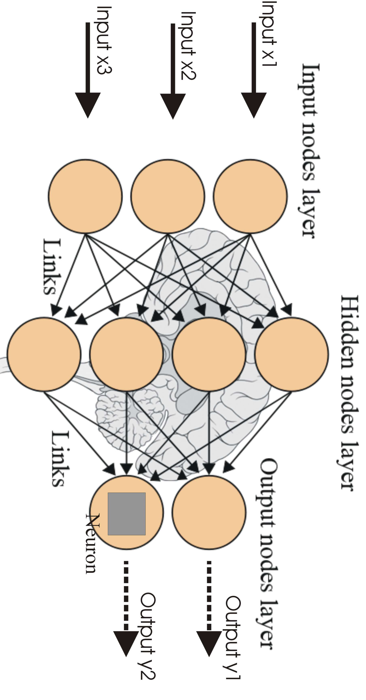
What Are Neural Networks
Definition
A neural network is a computational model composed of interconnected units called neurons.
Each neuron receives input, processes it, and sends output to other neurons.
How they work
Networks learn by adjusting the strength of connections (weights) using a Learning Rule.
Weights are updated thousands or millions of times until the network finds pathways that successfully identify patterns.
Effective for analyzing images, sounds, transactions, and other high-dimensional data.
Networks learn patterns by strengthening successful pathways and weakening unsuccessful ones.

Slide 20
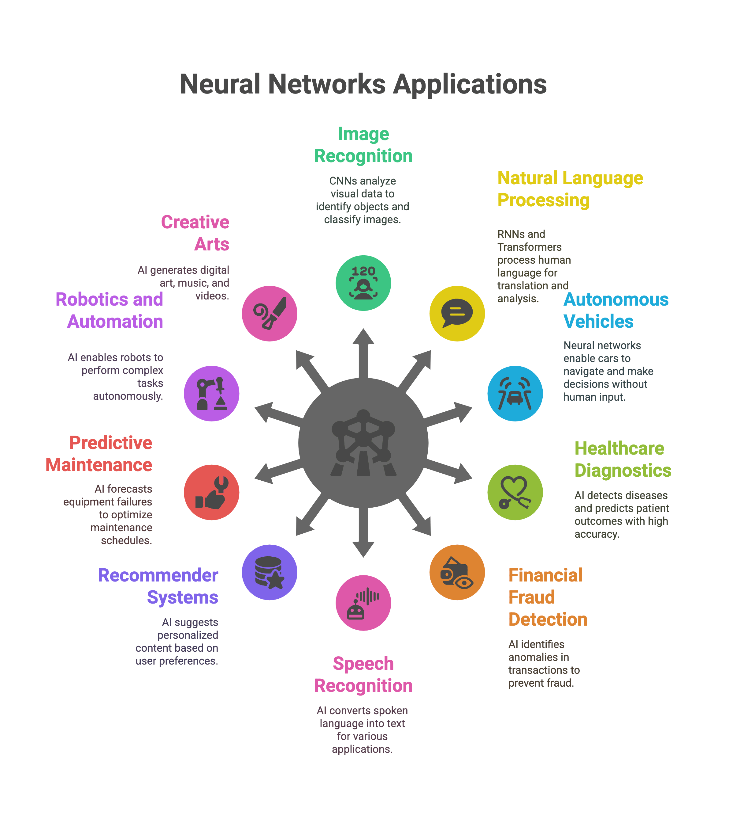
Neural Network Applications
Medicine
Screening for coronary artery disease.
Diagnosing epilepsy or Alzheimer’s disease.
Identifying cancer in pathology and radiology images.
Finance
Detecting credit card fraud.
Predicting equity performance or corporate bond ratings.
Identifying patterns that may signal bankruptcy risk.
Business
Forecasting sales or demand.
Classifying customer behavior.
Detecting suspicious phone calling patterns.

Slide 21
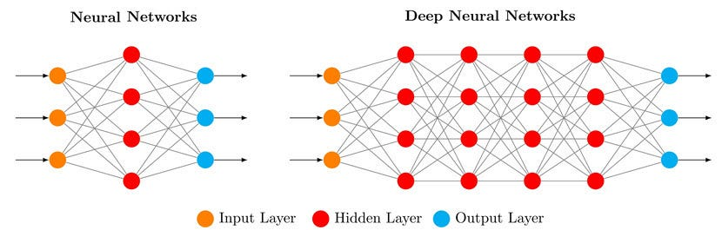
Deep Learning Neural Networks
What makes deep learning different
Uses many layers of neurons, allowing more complex transformations of input data.
Early layers find edges and shapes, while later layers identify complex patterns such as faces or objects.
Particularly effective for unlabeled data and complex pattern detection.

Slide 22

AlphaGo Movie (2017, September 19). AlphaGo Official Trailer [Video]. YouTube. https://youtu.be/8tq1C8spV_g?si=yhIhYJgmSdKJyOvn

Slide 23
Generative AI

Slide 24
Generative AI
Definition
Generative AI (GenAI) is a type of machine learning model trained to create new content.
GenAI learns patterns and structures from existing data and produces original outputs.
What GenAI can generate
Textual responses, essays, articles, fiction, and poetry.
Images and graphics.
Software programs and code.
Musical compositions.
Why it matters
Extends ML beyond prediction to content creation.
Mimics some features of human creativity.
Expected to transform how people create content and perform work.

Slide 25
Foundation Models and Transformers
Foundation Models
Large general-purpose neural models trained on broad and diverse datasets.
Can perform many tasks without needing to be rebuilt for each one.
Organizations can fine-tune them for specific business needs, which reduces cost and development time.
Provide the base for tools such as ChatGPT, Copilot, Gemini, Claude, and DALL-E.
Transformers
A neural network architecture that allows models to understand context within long sequences.
Uses attention to track relationships between words, sentences, or components of data.
Enables more accurate and coherent text generation, translation, and coding assistance.
Made it possible to train very large foundation models that power modern GenAI systems.

Slide 26
Large Language Models (LLMs)
A type of foundation model trained on very large text-based datasets.
LLMs do not understand meaning but predict likely text.
Capabilities
Infer meaning from context.
Provide coherent and relevant responses.
Translate languages.
Summarize or rewrite documents.
Assist in creative writing or software coding.
Powers intelligent chatbots, research assistants, virtual agents, and many workplace applications.

Slide 27
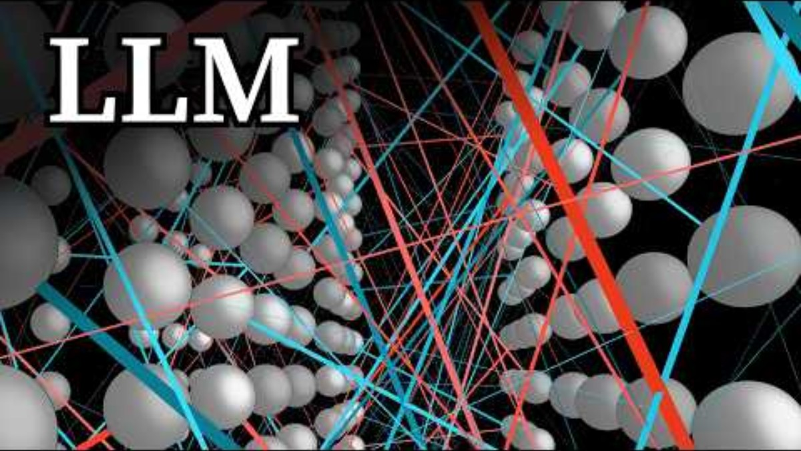
3Blue1Brown (2024, November 20). Large Language Models explained briefly [Video]. YouTube. https://youtu.be/LPZh9BOjkQs?si=R9VOQvQvmmDrBfnh

Slide 28
Multimodal AI and Enterprise Risks
Multimodal AI
AI that can process and generate multiple forms of input such as text, images, audio, video, and code.
Enables applications like document analysis with images and tables, visual question answering, automated inspection, and richer customer support.
Used in tools such as GPT-4, Gemini, and DALL-E for more flexible and realistic content generation.
Enterprise Risks
Data privacy concerns when sensitive information is shared with GenAI tools.
Intellectual property issues related to generated content or training data sources.
Bias and fairness problems if models reflect biased training data.
Accuracy and reliability risks, including hallucinations that produce incorrect or fabricated information.
Emerging regulations require oversight, transparency, and responsible deployment of AI tools.

Slide 29
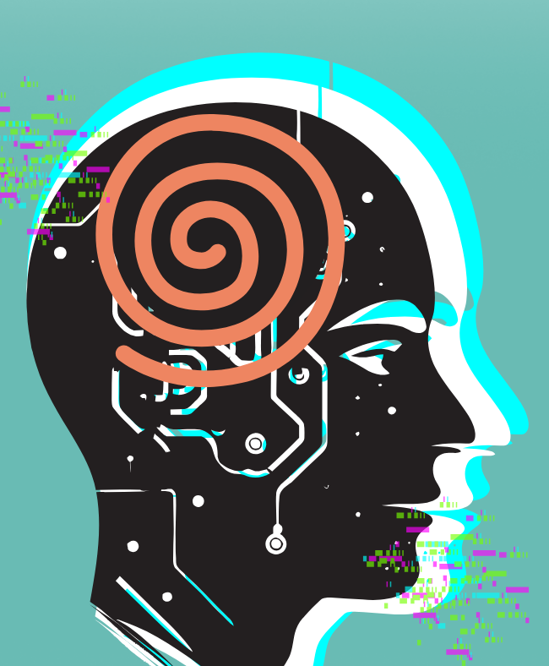
Accuracy and Hallucination Risks
GenAI may generate answers that are incorrect, misleading, or nonsensical.
These errors occur because the model reproduces patterns from training data rather than comprehension.
Limitations:
No moral judgment or awareness.
Does not understand meaning, intention, or truth.
Generates content based on statistical patterns, not comprehension.
GenAI is powerful and versatile but must be used with human oversight and verification.

Slide 30

FOX 5 Washington DC (2023, June 1). Lawyers using ChatGPT falsified court case [Video]. YouTube. https://youtu.be/wcG7s7Nm3EU?si=wNoHVSNJeqsHwD9P

Slide 31
Intelligent Agents

Slide 32
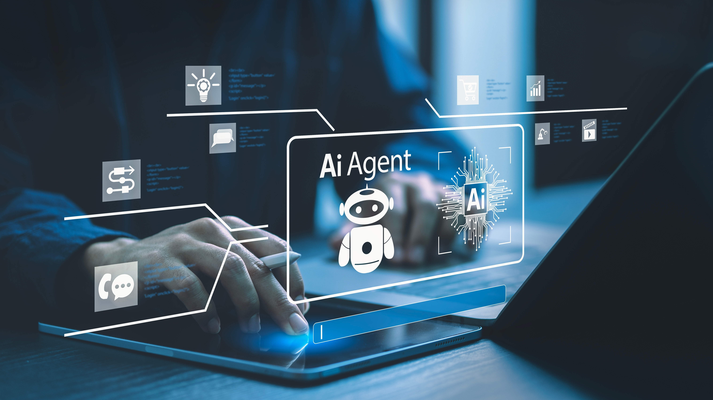
What Are Intelligent Agents
Software programs that use built-in or learned knowledge to work in the background to perform tasks without direct human intervention.
Can reduce labor costs, improve decision making in organizations, improve customer experience with personalized and faster responses.
What They Can Do:
Filter spam emails
Schedule appointments
Recommend purchases
Control devices such as thermostats
Support navigation in autonomous cars
Power virtual assistants, chatbots, and search tools

Slide 33
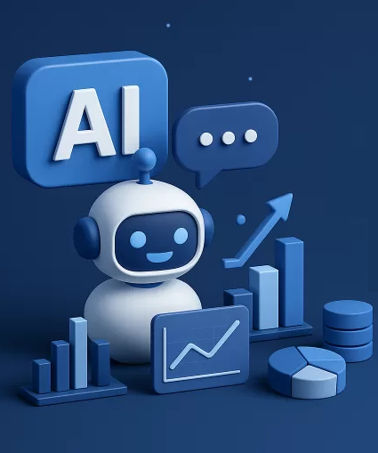
Business Impact of Intelligent Agents
Tools:
Chatbots, Virtual Assistants, Crawlers, etc.
Trends:
Integration with GenAI enabling more natural interactions.
Virtual assistants becoming more context-aware.
Chatbots used widely for customer support and e-commerce.
Risks:
Poor user experience if bots fail to understand context.
Privacy concerns when processing personal data.
Dependence on systems that may produce errors.

Slide 34
Natural Language Processing

Slide 35
Natural Language Processing
Natural Language Processing (NLP) enables computers to understand and work with human language (text or speech), including unstructured data.
Uses machine learning and deep learning trained on large language datasets to identify meaning, intent, and relationships in text or speech.
Trained on millions of text or speech examples.
Learns patterns such as grammar, topic shifts, tone, and intent.
Earlier models relied on keywords and preset responses and could not adapt to new vocabulary or complex phrasing.
Modern NLP with deep learning identifies meaning from examples rather than fixed rules, enabling more flexible and natural interaction.
Because human language is ambiguous, NLP is essential for systems like search engines, chatbots, assistants, and analytics.

Slide 36
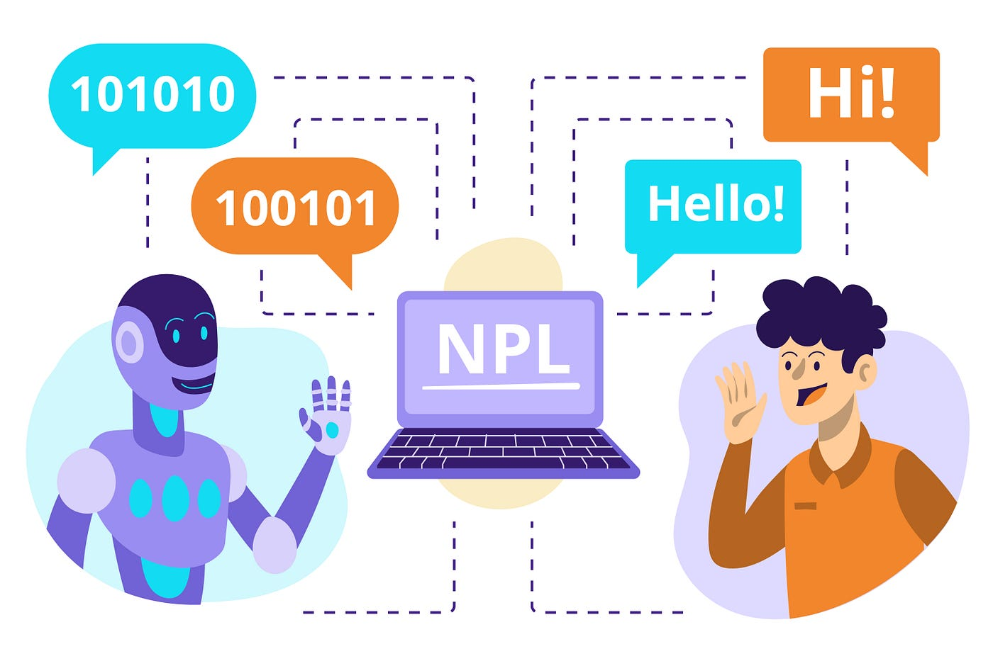
NLP Challenges
Language Ambiguity
Meanings may depend on tone, dialect, cultural context, and even stress on words.
e.g., “I didn’t say he stole the money.”
Speech Complexity
Accent, speed, and background noise may reduce recognition accuracy.
Detecting emotion or sarcasm is less reliable.
Evolving Language
Language changes constantly, and models require frequent retraining.

Slide 37
NLP Applications
Healthcare
Hospitals use NLP to extract information from unstructured medical notes.
e.g., Akershus University Hospital used NLP to check diagnostic accuracy.
Customer Service and Support
NLP-driven chatbots reduce wait times and provide 24/7 support.
Banks, airlines, and retailers use NLP for triage and automated responses.
Language Tools
Google uses NLP to interpret queries, understand intent, and rank relevant results.
News and productivity tools use NLP to summarize long articles or reports
Business Intelligence
Companies analyze millions of customer comments for trends, complaints, and opportunities.
Used for sentiment analysis, topic detection, and customer feedback mining.

Slide 38
Computer Vision

Slide 39
Computer Vision
Computer vision uses AI to enable machines to interpret images and videos.
Built on deep learning models trained on millions of labeled images.
Systems detect objects, people, defects, movements, and patterns in visual data.
How It Works
Cameras collect visual data.
AI models analyze the visuals to classify, detect, or track objects.
Insights trigger actions such as quality alerts, safety detection, or navigation decisions.
Why We Care
Automates tasks that rely on visual inspection.
Reduces labor costs and error rates.
Enables new capabilities like autonomous vehicles, smart stores, and safer workplaces.

Slide 40
Computer Vision Applications
Retail & Customer Experience
Amazon Go stores use vision to track items shoppers pick up, enabling “just-walk-out” checkout.
Retailers analyze foot traffic, shelf engagement, and customer demographics.
Manufacturing & Quality Control
Automated defect detection on assembly lines reduces waste and recalls.
Systems check labeling, packaging integrity, and product dimensions.
Healthcare & Diagnostics
AI reads X-rays, MRIs, and CT scans to detect tumors or disease earlier.
Helps radiologists reduce workload and increase diagnostic accuracy.
Security & Access Control
Facial recognition for secure entry, attendance tracking, or fraud detection.
Airports use vision for identity verification and baggage screening.

Slide 41
Computer Vision Risks
Data and Privacy Concerns
Facial recognition and surveillance raise legal and ethical issues.
Requires strict compliance with privacy laws (GDPR, state biometric laws).
Accuracy and Bias Risks
Models may misidentify people or defects, especially in low-quality images.
Performance can drop significantly in poor lighting or unusual camera angles
Bias can occur if training data is skewed.
Cost & Implementation
Requires high-quality cameras, storage, and computing power.
Integration with existing workflows may demand process redesign.
Workforce Implications
Reduces manual inspection but increases demand for technical oversight and maintenance.

Slide 42
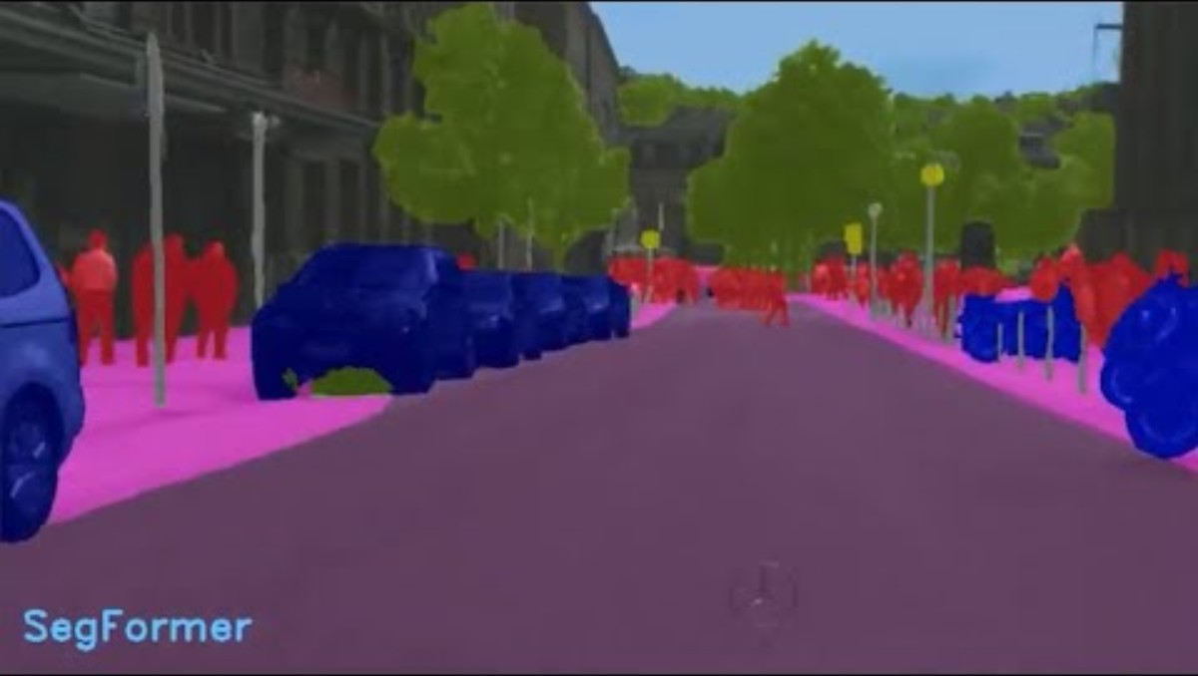
NVIDIA (2022, March 21). What Is Computer Vision & Why Does It Matter? [Video]. YouTube. https://youtu.be/OnTgbN3uXvw?si=KXM9xJbX2VFowSVf

Slide 43
Robotics

Slide 44
Robotics
Robotics focuses on designing and operating machines that can perform physical tasks automatically.
Robots follow programmed actions but increasingly use sensors and AI to adapt to their environment.
Common uses include manufacturing, logistics, healthcare, military, and dangerous environments.
Why It Matters in Business
Increases productivity and consistency.
Automates dangerous, repetitive, or physically demanding tasks.
Expands what companies can do, from rapid fulfillment to precision surgery.

Slide 45
Robotics Applications
Manufacturing
Assembly line robots handle welding, painting, parts assembly, and heavy lifting.
e.g., Foxconn uses 300,000+ robots to assemble electronics.
Logistics & Warehousing
Amazon, Walmart, FedEx use robots for picking, sorting, transporting goods.
e.g., Amazon operates 750,000+ robots across fulfillment centers.
Healthcare
Surgical robots improve precision and reduce patient recovery times.
Hospital service robots deliver linens, medications, and supplies (e.g., TUG robot).
Hazardous or Remote Environments
Robots for bomb disposal, nuclear inspection, firefighting support.
Humanoid robots (emerging) assist in inspection at power plants or in space missions.

Slide 46
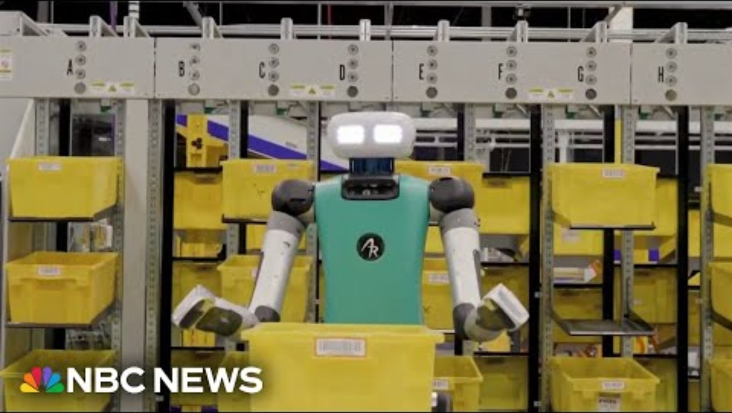
NBC News (2023, December 12). Inside Amazon’s robot revolution [Video]. YouTube. https://youtu.be/ZWonAz7Kczs?si=NicjTU8vPEcsa8wN

Slide 47
Robotics Risks
High cost of robots and system integration (both up-front and ongoing maintenance).
Safety concerns when humans and robots interact.
Operational disruptions if robots malfunction or are hacked.
Ethical and legal concerns for autonomous systems, including worker privacy.
Workforce Impact
Automation may replace repetitive or dangerous jobs
Skill requirements shifts towards technicians and coders.
Workers may shift from manual tasks to oversight and quality control
Concerns about job displacement can affect morale and organizational culture

Slide 48
Other AI Technologies

Slide 49
Genetic Algorithms
Genetic Algorithms (GAs) search for optimal solutions by evolving many possible solutions over multiple generations.
How they Work
Start with a population of candidate solutions encoded as binary strings.
Evaluate each solution using a fitness score.
Generate new solutions through selection, crossover, and mutation.
Repeat until the algorithm converges on a strong solution.
Applications and Limitations
Applied in logistics, production scheduling, engineering design, and GPU optimization.
Require well-defined fitness criteria.
Can be computationally intensive and may converge slowly.

Slide 50
Expert Systems
Expert systems use IF–THEN rules to capture the knowledge of human experts and automate structured decisions.
Especially useful when rules are clear and stable, such as credit decisions, diagnostics, troubleshooting, and compliance checks.
How they work
A knowledge base stores rules from experts.
An inference engine evaluates user inputs and “fires” rules to reach a conclusion.
Works well for structured, repeatable problems.
Limitations
Hard to scale or update as rules grow into the thousands.
Cannot handle ambiguity or rapidly changing environments.
Largely replaced by data-driven ML systems, but rule-based systems remain common in workflows.

Slide 51
Fuzzy Logic
Fuzzy logic models human reasoning by handling imprecise or subjective categories such as “warm,” “high,” or “medium.”
How they Work
Uses membership functions to represent degrees of truth (e.g., a temperature can be partly “cool” and partly “warm”)
Rules combine these fuzzy values to make smooth, continuous decisions.
Enables systems to adjust outputs gradually rather than making abrupt on/off changes.
Applications
Consumer appliances such as washing machines, dryers, and air conditioners adjust settings based on fuzzy inputs.
Automotive systems optimize gear shifting or braking based on driving conditions.
Industrial and environmental control systems refine heating, cooling, or chemical processes.

Slide 52
Challenges of AI

Slide 53
AI Challenges: An Overview
AI provides major benefits but introduces serious risks organizations must manage.
Key challenges include:
Hallucinations
Lack of Transparency
AI Bias
Cybersecurity Threats
Job Loss and Inequality
Environmental Impact
Misinformation
Loss of Privacy
Intellectual Property Issues

Slide 54
AI Challenges
AI hallucinations occur when a model produces incorrect answers with confidence.
Causes include insufficient training data, flawed assumptions, and biased datasets.
Errors include false positives, false negatives, and incorrect predictions.
High hallucination rates reduce trust and limit use in healthcare, finance, legal work, and analytics.
AI transparency refers to understanding how a model reaches its decisions.
Larger models are often more opaque and difficult or impossible to explain.
It is hard to detect or fix harmful behavior and nearly impossible to audit or defend decisions.
Transparency includes exposing data sources, error patterns, and limitations.
AI bias results from biased training data, flawed algorithms, or developer cognitive bias.
Examples include racial disparities in medical AI, predictive policing, and biased hiring algorithms.
Biased datasets amplify existing inequalities and reduce model accuracy.
Managers must evaluate datasets, audit models regularly, and monitor unintended consequences.

Slide 55
AI Challenges
AI creates new cybersecurity risks even as it strengthens defense tools.
Attackers use AI to craft targeted phishing and malware.
Deepfakes can bypass facial or voice authentication.
LLMs are vulnerable to prompt injection that forces harmful or unauthorized outputs.
AI may replace certain tasks and contribute to unequal impacts across the workforce.
Both lower skill and white-collar roles face automation pressure.
Displacement is projected to affect women and minority groups disproportionately.
Workers who lack technical skills may be unable to shift into new AI-complementary roles.
AI increases efficiency but also has substantial energy and resource demands.
AI-powered searches and model training consume far more electricity than traditional computing.
Data centers require significant cooling water, straining supply in some regions.
Rapid turnover of AI hardware contributes to global e-waste growth.

Slide 56
AI Challenges
AI accelerates the creation and spread of false or manipulated content.
Tools generate realistic synthetic images, audio, and video.
False content spreads quickly on social platforms and affects political discourse.
AI systems raise significant concerns about the collection and use of personal data.
Training data may include unauthorized or sensitive information.
User queries can become part of future training sets and appear elsewhere.
Facial recognition systems often gather images without consent.
AI complicates ownership and fair use of creative works.
Models are trained on copyrighted content scraped from the web.
Hard to determine human contribution versus machine output.
Complex models make it impossible to trace which training data informed an output.

Slide 57
Recap of Chapter 11

Slide 58
Recap of Chapter 11
Understand AI.
Describe the various types of AI Technology.
Machine Learning
Neural Networks and Deep Learning
Generative AI
Intelligent Agents
Natural Language Processing
Computer Vision
Robotics
Genetic Algorithms, Expert Systems, Fuzzy Logic
Understand the challenges posed by AI.

